Slide 1

An Application for secure SMS exchange

Slide 2


Serpent algorithm

Slide 3
Background
Was designed by Ross Anderson, Eli Biham and Lars Knudsen
It was first introduced in 1997
A Finalist in the Advanced Encryption Standard(AES) contest, got 2nd place after Rijndael algorithm

Slide 4
Description
Symmetric-key block cipher
Same key is used for encryption and decryption
Accepts key sizes of any length
128, 192, 256 bit key lengths supported
Uses 8 different 4-bit S-boxes
Each S-box contains 16 elements
A total of 32 times
32 round block cipher
Works on fixed-length group of bits
Has a 128-bit block size
Broken into 4 of 32-bit words

Slide 5
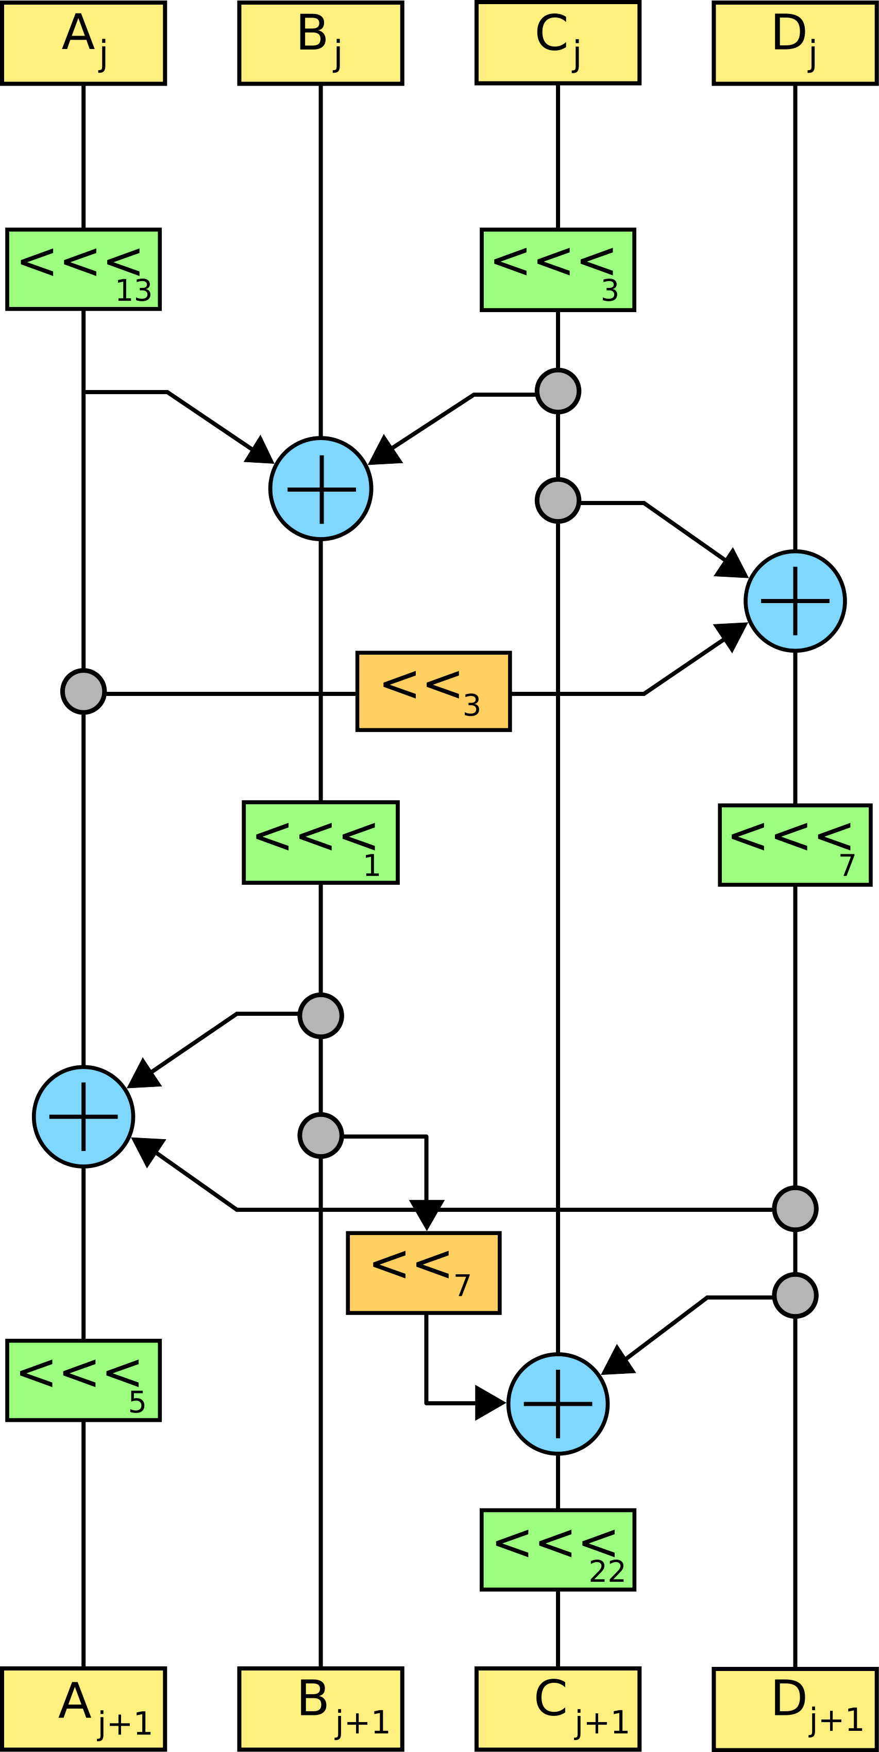
The cipher
An initial permutation IP
32 rounds of key mixing
A pass-through S-box and(in all but the last round ) linear transformation
In the last round the LT replaced by additional key mixing
A final permutation FP
In the end we chain the blocks

Slide 6



Key Scheduling
rgge
The key scheduling algorithm of Serpent is defined for 256-bit keys
Shorter keys are padded by a single bit of 1 followed by as many bits of 0’s required to have a total length of 256 bits
Round keys are then generated by :
Recurrence operation with previous round keys (and the initial key at start)
A pass through one of the 8 S-boxes (starting with S3 and working down)

Slide 7
Encryption
Encrypt the 128-bit bitstring 'plainText' with the 256-bit bitstring 'userKey', using the normal algorithm, and return a 128-bit ciphertext bitstring

Slide 8
Decryption
Decrypt the 128-bit bitstring 'cipherText' with the 256-bit bitstring 'userKey', using the normal algorithm, and return a 128-bit plaintext bitstring

Slide 9
ecb mode
The simplest of the encryption modes
used to encipher a single plaintext block
The message is divided into blocks, and each block is encrypted separately

Slide 10
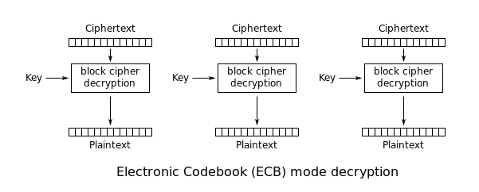
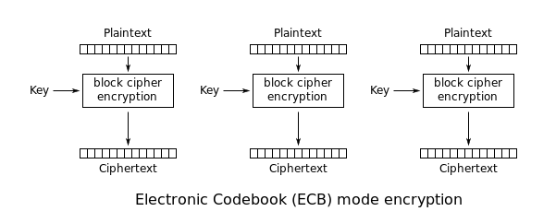
ECB ENCRYPTIN AND Decryption

Slide 11
Implementation in Our Project
We used ECB mode of serpent to encrypt and decrypt the messages between two users.
ECB was used because it is a synchronous stream cipher, which means key stream is generated independently of plaintext and cipher text.
We provided serpent with unique key and message data will be streamed to the serpent into block of certain size.

Slide 12
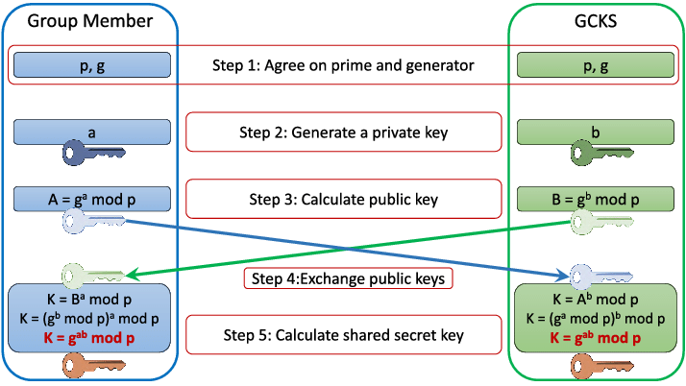
Causal Diffie-Hellman:
1- Alice and Bob publicly agree to use a large prime P and base (generator) G
2- Alice chooses a secret integer a, then sends Bob A = G^a mod P
3- Bob chooses a secret integer b, then sends Alice B = G^b mod P
4- Alice computes s = B^a mod P
5- Bob computes s = A^b mod P
6- Alice and Bob now share a secret key.

Slide 13
Improving Diffie-Hellman with Elliptic Curve:
Same princible as Casual Diffie-Hellman, But for now, Our G is a point on curve
Both sides add B to it self, much times according to their private key
In the end we get (ab)G and its our secret shared key
This is way more secured than Casual Diffie Hellman
Because extracting the private keys (a,b) from aG, bG, is a DLP (Discrete Logarithm Problem) meaning it has a massive complexity, that will take forever to solve
Multiplication of G with a scalar, is like a one way function
We use Hash to transfer the shared secret key.

Slide 14
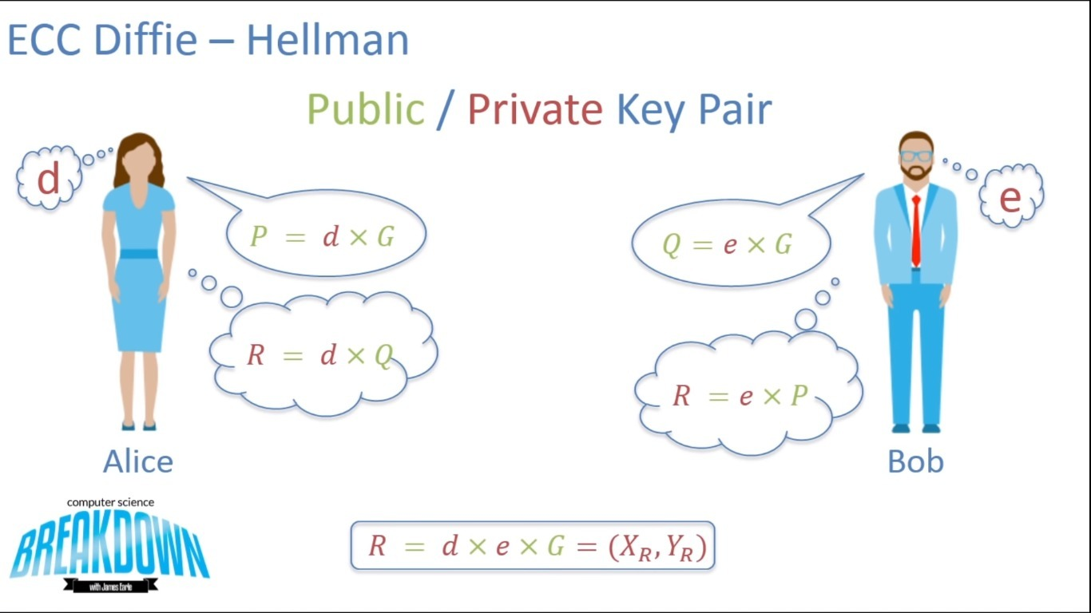
Elliptic Curve Cryptography & Diffie-Hellman

Slide 15
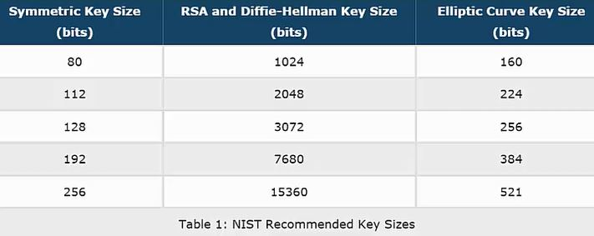
Lets check some stats:
For the same level of security, we can see that Elliptic Curve needs a much smaller key size than RSA

Slide 16
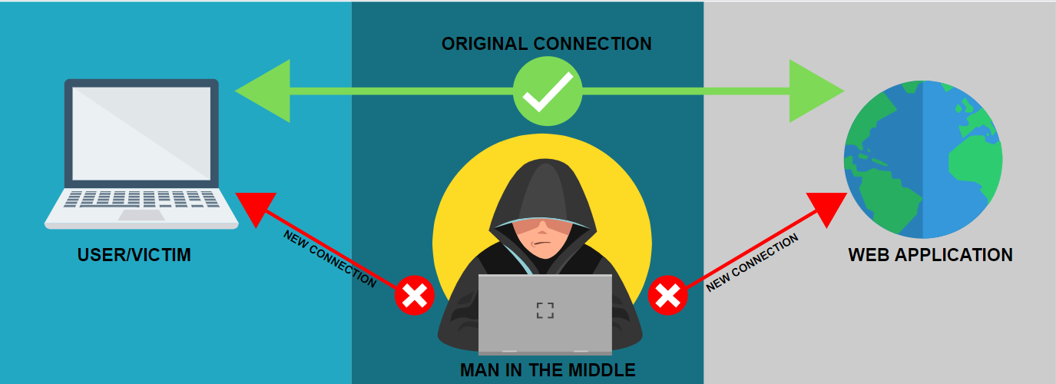
Man In The Middle:
A third party in the middle, can intercept the key generation between Alice and Bob
Thus generating 2 shared keys, to share with Bob and Allice
Diffie-Hellman alone IS IN DEEP TROUBLE here
So what do we do? we use the help of RSA

Slide 17
RSA
Developed by Rivest, Shamir, and Adleman (1977)
Most widely used public key algorithm
Receives its security from the difficulty of factoring large numbers
Actually discovered first by UK GCHQ (Ellis and Cocks) in 1973 !
Algorithm:
Works as a block cipher, where each plaintext/ciphertext block is integer between 0 and n (for some n=2^{k})
Each receiver chooses e, d
The values of e, and n are made public; d is kept secret
Encryption: C=Me mod n
Decryption: M=C^{d} mod n = M^{ed} mod n
The RSA algorithm is an asymmetric cryptography algorithm; this means that it uses a public key and a private key (i.e two different, mathematically linked keys). As their names suggest, a public key is shared publicly, while a private key is secret and must not be shared with anyone.

Slide 18
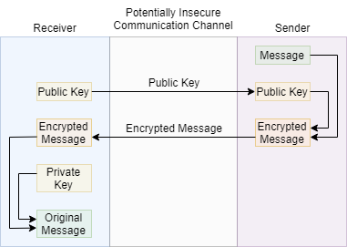
RSA Use
to encrypt a message M the sender:
obtains public key of recipient k₁ ={e,n}
computes: C=Me mod n, where 0≤M ≤ n
to decrypt the ciphertext C the owner:
uses their private key k₂ ={d,p,q}
computes: M=C^{d} mod n
note that the message M must be smaller than the modulus n (block if needed)

Slide 19
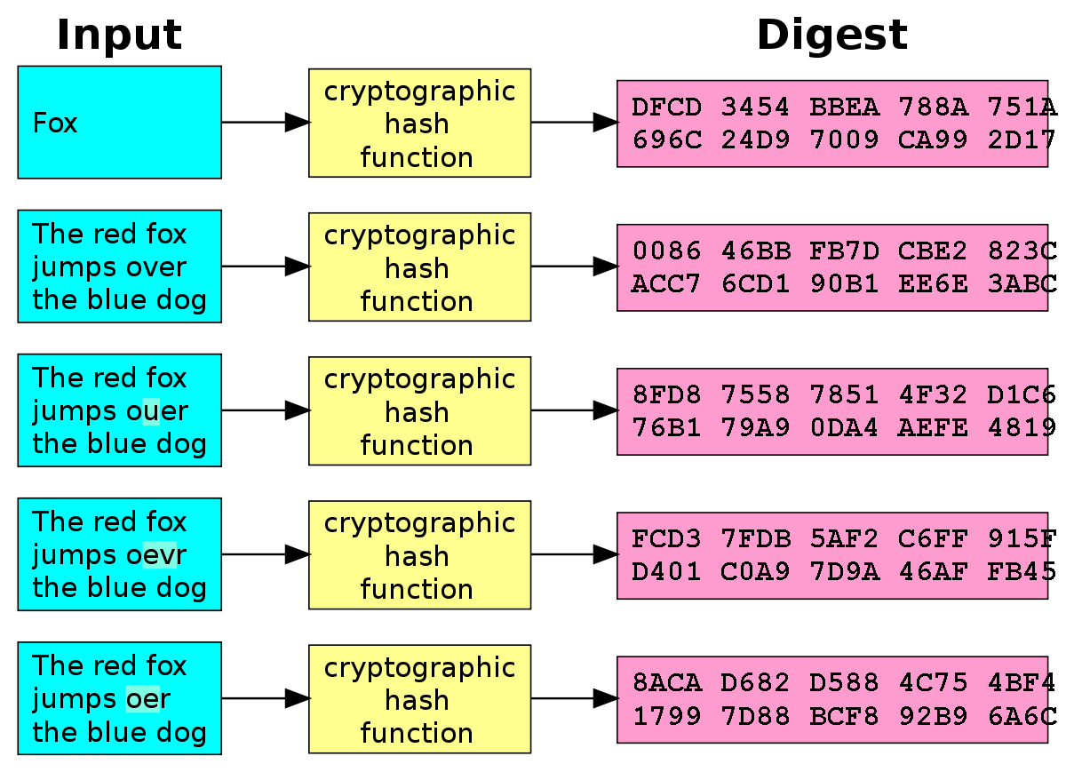
Hash function
Fixed output size for all the inputs.
Weak collision resistance, if given a hash value H(x) we cant find another x’, that has the same hash value.
Strong collision resistance, we cant find two messages that have the same hash, H(x)=H(x’).
One-way property, we cant find x, having H(x).
Hash function is similar to Digital Signature, but it lacks features to be one.

Slide 20
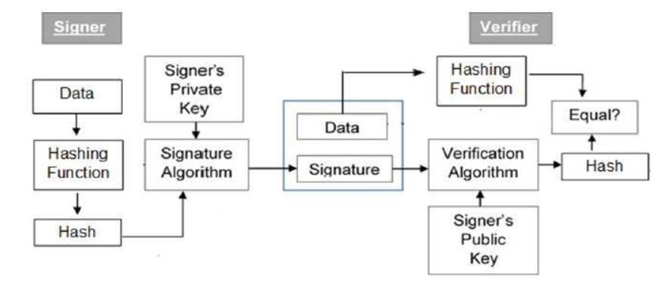
signature
Digital signatures are the public-key primitives of message authentication. In the physical world, it is common to use handwritten signatures on handwritten or typed messages. They are used to bind signatory to the message.
Similarly, a digital signature is a technique that binds a person/entity to the digital data. This binding can be independently verified by receiver as well as any third party.
Digital signature is a cryptographic value that is calculated from the data and a secret key known only by the signer.
In real world, the receiver of message needs assurance that the message belongs to the sender and he should not be able to repudiate the origination of that message. This requirement is very crucial in business applications, since likelihood of a dispute over exchanged data is very high.

Slide 21
RSA Signature
RSA signature is a type of digital signature, which uses the RSA asymmetric key algorithm.
RSA signature is the most widely use digital signature in practice.
First described in 1978 in a paper that called "A Method For Obtaining Digital Signature and Public- Key Cryptosystem" written by Rivest, Shamir, and Adleman

Slide 22
How RSA Signature Works
When a sender want to send a message with his signature, he produces the hash value of the message.
Then he raised the hash value to the power of d (modulo n) .
Finally attach it to the message.
The recipient uses the same hash algorithm in conjunction with the public key.
The recipient raises the signature to the power of e (modulo n).
Compares the resulting hash value with the message's hash value.
If the two agree, the recipient knows that the author of the message was in possession of the sender private key, and that the message has not been tampered with since being sent.

Slide 23
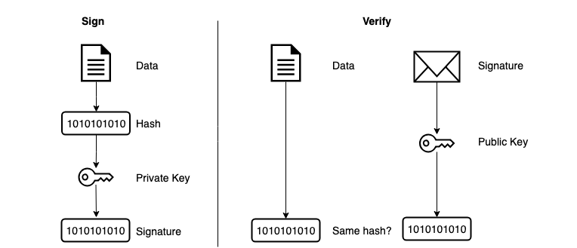
RSA signature Cont.

